Slide 1
How can Sussex County
better protect our trees!

Slide 2
VISION “Sussex County offers a unique quality of life for its residents and visitors alike. We appreciate and seek to preserve its unique natural, historical and agricultural character while fostering new economic opportunities, community vitality, and desirable growth through strategic investments and efficient use of County resources. To accomplish this, Sussex County will balance the welfare of its citizens and its role as an agricultural, tourism, and business leader with the most appropriate future uses of land, water and other resources.”

Slide 3
Future Land Use Vision: To provide for balanced and well-planned future growth and
development that supports the County’s economic development goals while preserving the rural character of the County and its natural resources.
Conservation Vision: To conserve land and protect natural resources in balance with growth and development throughout Sussex County.
“County officials have the responsibility and authority”

Slide 4
Today……
Development Design Initiative
Importance of Trees
Jurisdiction Comparisons
Summary of Findings
Recommendations

Slide 6
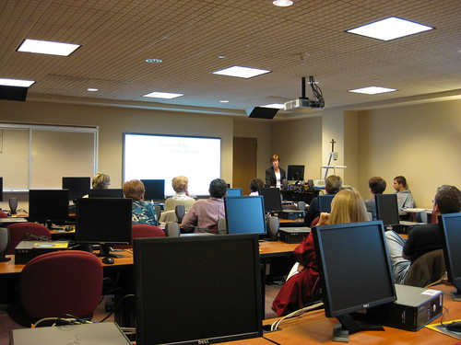
SUSSEX COUNTY COUNCIL “DEVELOPMENT DESIGN” IDEAS
MARCH 7, 2023
# 1
County Council asked staff to provide a list of potential updates to the County Code in reference to “development design”
Council requested items related to open space, buffers, forest preservation, etc.
The following list was created to seek Council feedback and direction on five broad categories:
1. Open Space
2. Superior Design
3. Subdivision Standards
4. Forest Preservation
5. Site Work

Slide 7
# 2
Adoption of Wetland Buffer Amendments

Slide 8
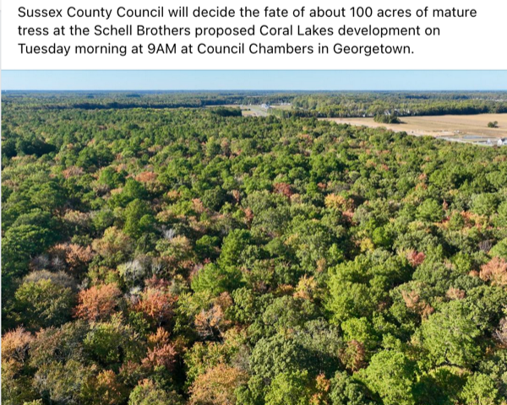
Before
# 3

Slide 9
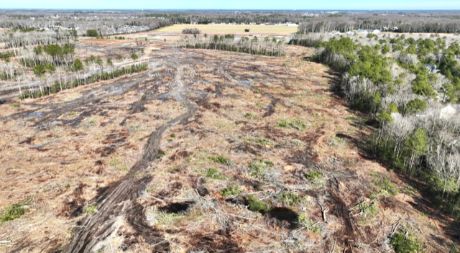
After
# 3

Slide 10
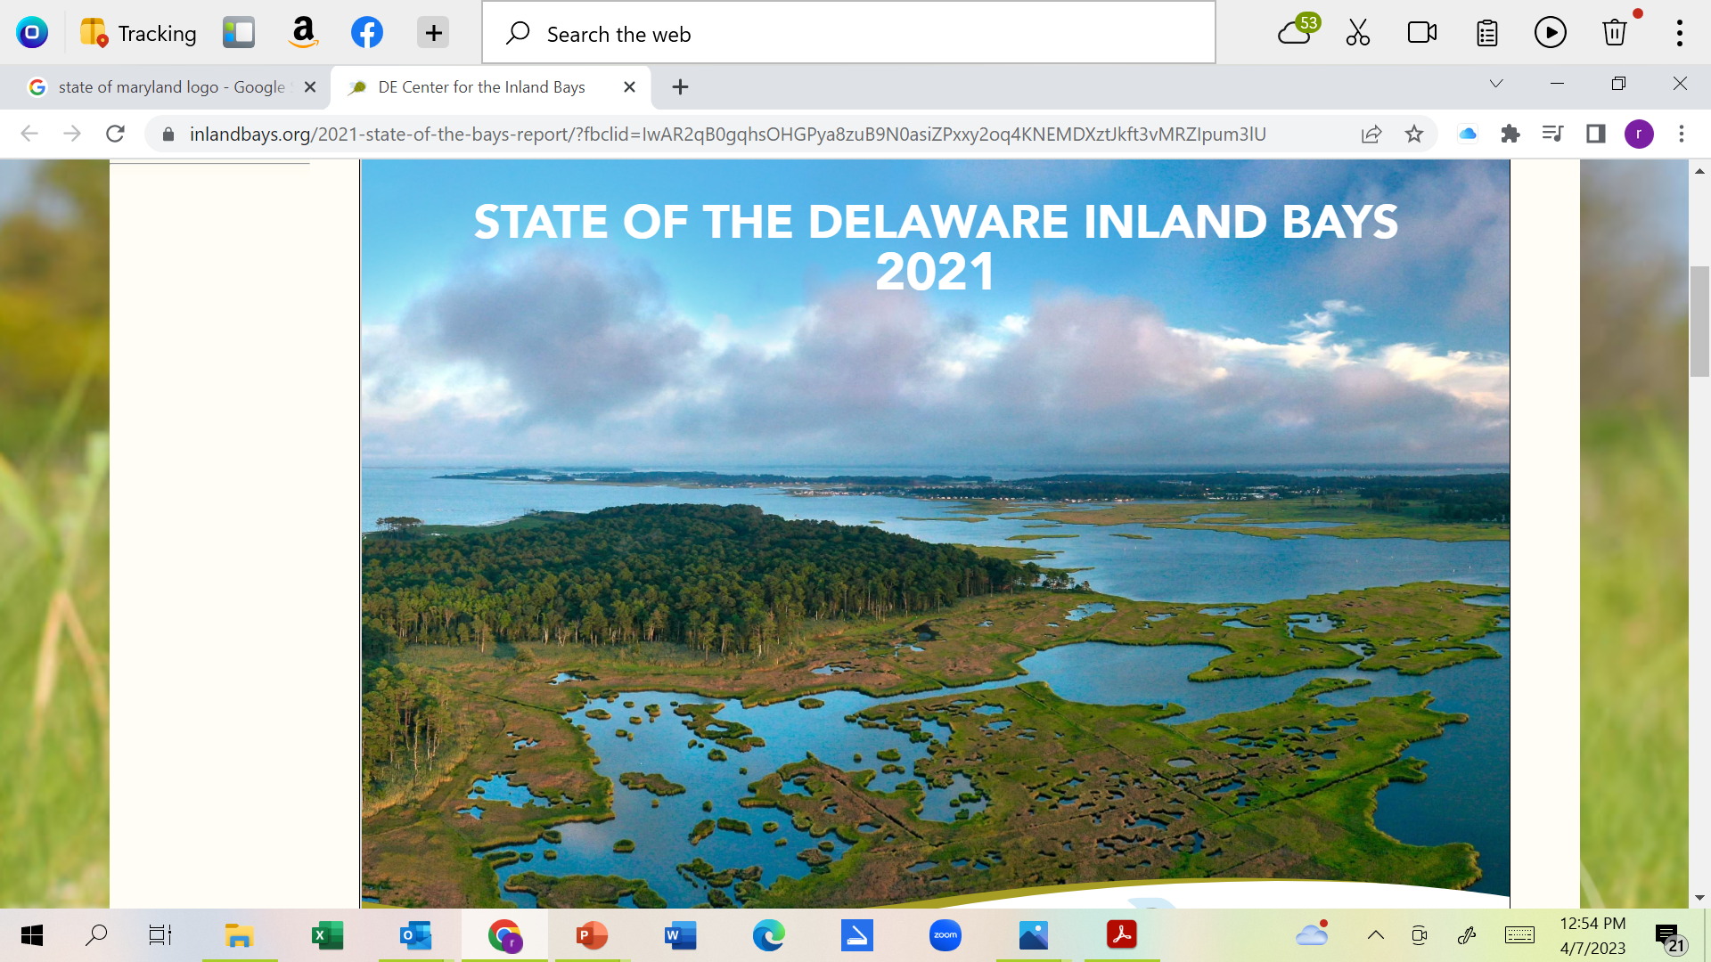
# 4

Slide 11
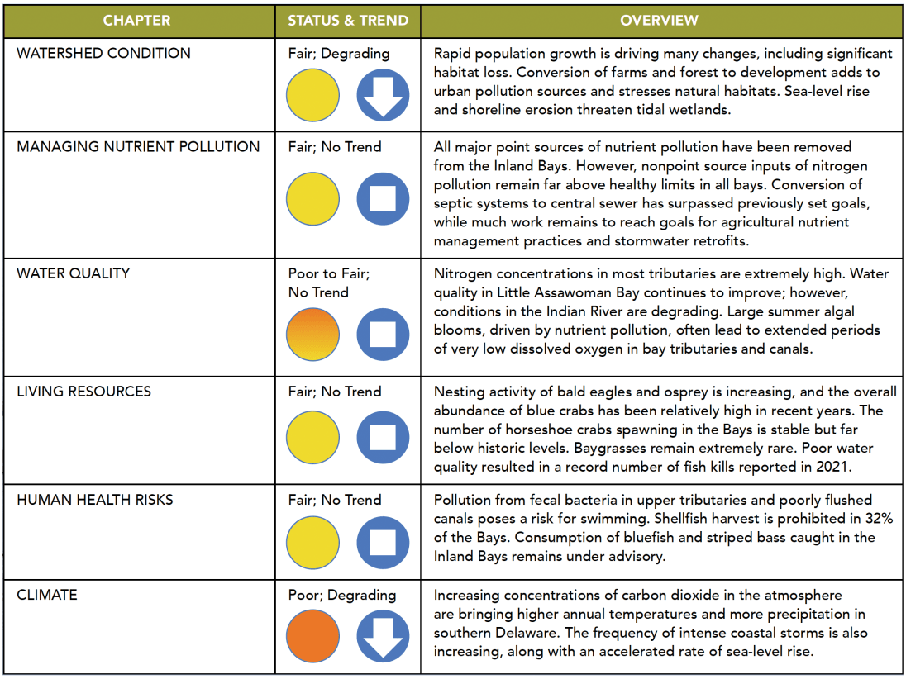
# 4
The Inland Bays’ water quality as a whole received a “POOR” or “D” rating—exactly the same as five years ago

Slide 12
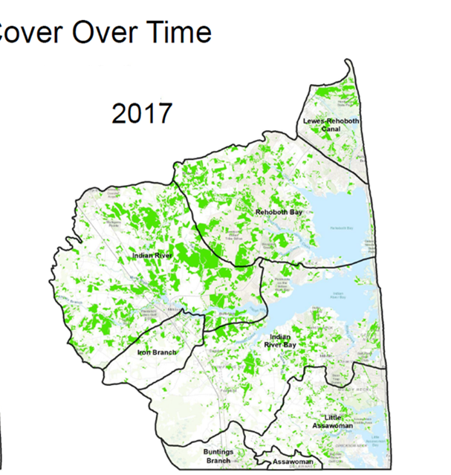
#5
“Not surprisingly, nearly all the losses in forestland since 1986 have occurred in Sussex County, Delaware’s most rural county and home to an ever-increasing demand for coastal community development.”
2022
Why are trees important to you?

Slide 13
Importance of Trees
They clean our air, filter our water, and even slow storm surge and flooding in our cities.
Trees play a critical role in creating healthier, safer, and more connected communities.
Even as social and economic issues fracture our society, trees continue to connect communities, cultures, and generations.
Neighborhood trees have shown the ability to reduce stress, improve overall health and development in children, and encourage physical activity.
A healthy communitywide tree canopy fosters economic advantages as well as an increase in civic pride among residents.

Slide 14
Comparisons Factors
Purpose
Applicability
Delineation
Forest Plan
Afforestation
Mitigation/ Waivers
Enforceability
Violations

Slide 15
Purpose
Applicability
Delineation
Forest Plan
Afforestation
Mitigation/ Waivers
Enforceability
Violations
Sussex County DE
§ 99-5 & 99.9
Definitions.
§ 99-5
Forested and /or Landscape Buffer Strip
Landscape plans for a forested buffer area whose stated purpose is to filter views from and into the subdivision in such a manner that the areas on the agricultural side of the buffer area appear more green and less visible and the structures or uses on the subdivision side appear less obvious and less dense than if no landscaping had been required.

Slide 16
Purpose
Applicability
Delineation
Forest Plan
Afforestation
Mitigation/ Waivers
Enforceability
Violations
Kent County, DE
Part II, General Legislation / Subdivision and Land Development
§ 187-73 Woodland preservation.
Tree Protection Area
To establish standards and requirements for the protection and planting of trees and woodlands because it is recognized that woodlands and trees are not only desirable, but are also essential to the health, safety, and welfare of the population in that they provide oxygen, reduce carbon dioxide, stabilize soil, cleanse the air by transpiring clean water into the atmosphere, cleanse water passing into the ground through the root system, provide protection for wildlife and their habitats, provide shade, reduce noise and glare, increase property values, and provide an important physical, aesthetic, and psychological balance to the built environment.

Slide 17
Purpose
Applicability
Delineation
Forest Plan
Afforestation
Mitigation/ Waivers
Enforceability
Violations
Maryland Statutes
Natural Resources
Title 5 - Forests and Parks
Subtitle 16 - Forest Conservation Program
The main purpose of the Maryland Forest Conservation Act (Natural Resources Article Section 5-1601 through 5-1613) enacted in 1991 was to minimize the loss of Maryland's forest resources during land development by making the identification and protection of forests and other sensitive areas an integral part of the site planning process. Identification of priority areas prior to development makes their retention possible. Of primary interest are areas adjacent to streams or wetlands, those on steep or erodible soils or those within or adjacent to large contiguous blocks of forest or wildlife corridors.

Slide 18
Purpose
Applicability
Delineation
Forest Plan
Afforestation
Mitigation/ Waivers
Enforceability
Violations
Sussex County DE
§ 99-5
Definitions.
§ 99.9 Preliminary Plat Approval/Disapproval
In addition to the other provisions contained within the article, the approval shall contain consideration of the following: (17)
(3) Preservation of natural and historical features
(4) Preservation of open space and scenic views
(5) Minimization of tree, vegetation, soil removal and grade changes
Consideration is defined as “careful thought : deliberation. : thoughtfulness”

Slide 19
Purpose
Applicability
Delineation
Forest Plan
Afforestation
Mitigation/ Waivers
Enforceability
Violations
Kent County, DE
Part II, General Legislation / Subdivision and Land Development
§ 187-73 Woodland preservation.
Tree Protection Area
Any portion of a site wherein are located existing trees which are proposed to be retained in order to comply with the requirements of this section. The tree protection area shall include no less than the total area beneath the tree canopy as defined by the dripline of the tree or group of trees collectively.

Slide 20
Purpose
Applicability
Delineation
Forest Plan
Afforestation
Mitigation/ Waivers
Enforceability
Violations
Maryland Statutes
Natural Resources
Title 5 - Forests and Parks
Subtitle 16 - Forest Conservation Program
The forest stand delineation shall be used during the preliminary review process to determine the most suitable and practical areas for forest conservation.

Slide 21
Purpose
Applicability
Delineation
Forest Plan
Afforestation
Mitigation/ Waivers
Enforceability
Violations
Sussex County DE
§ 99-5
Definitions
A strip of land, not less than 20 feet in width, exclusive of any residential lots, stormwater management areas or facilities, open space (except that the land area within the buffer strip may be included in the overall calculation of open space), recreational amenities, wastewater treatment and/or disposal facilities, water treatment facilities, streets, buildings or other surface improvements and located along the entire outer perimeter of any portion of a major subdivision of lands into four or more lots adjacent to land of other ownership.
A landscape plan for the buffer shall be designed and certified to by a licensed landscape architect, licensed forester or forester designated by the Society of American Foresters as a "certified forester." The landscape plan shall be reviewed and commented on by the State Forester and shall be subject to the final review and approval of the Commission.
The landscape plan may include suitable existing deciduous and evergreen trees of common local species.

Slide 22
Applicability
Delineation
Forest Plan
Afforestation
Mitigation/ Waivers
Enforceability
Violations
Kent County, DE
Part II, General Legislation / Subdivision and Land Development
§ 187-73 Woodland preservation.
Tree Protection Area
Inside the growth zone - Within the central portion of Kent County identified by the Kent County Comprehensive Plan as the growth zone, woodland areas shall be preserved in accordance with;
Use (residential/nonresidential
Density(DU's/acre) Mandated
Percentage of Existing Woodland Area to be Preserved
“Clearing prohibited without approval. Clearing, as defined by this section, for any purpose whatsoever, except the establishment of trails and pathways (not greater than eight feet in width) and open yard areas, shall be prohibited unless approved by the Regional Planning Commission through the site plan, conditional use, or subdivision review process.”
Outside of the growth zone - No more than 30% of a woodland area, tract or parcel may be cleared for any purposes outside of the designated growth zone.
“Trees of special value. Trees having an historic value, as determined by the Commission's staff, State Historic Preservation Officer, or the Delaware Forestry Service may be required by the Commission to be preserved.”
“Forest corridors and linkages. In designing subdivisions and land developments, applicants are encouraged to minimize forest fragmentation and maintain and create, whenever possible, forested corridors to link other forested tracts.

Slide 23
Purpose
Applicability
Delineation
Forest Plan
Afforestation
Mitigation/ Waivers
Enforceability
Violations
Maryland Statutes
Natural Resources
Title 5 - Forests and Parks
A proposed forest conservation plan shall contain:
A map of the site drawn at the same scale as the grading or subdivision plan;
A table listing the net tract area in square feet, the square foot area of forest conservation required for the site, and the square foot area of forest conservation provided by the applicant on-site and off-site, if applicable.
A clear graphic indication of the forest conservation provided on the site showing areas where both retention of existing forest or afforestation, by any and all methods, is planned;
In anticipated construction timetable, including the sequence for tree conservation procedures;
An afforestation or reforestation plan with a timetable and description of needed site and soil preparation, species, size, and spacing to be utilized;
Locations and types of protective devices to be used during construction activities to protect trees and areas of forest designated for conservation;
Limits of disturbance delineated;
Stockpile areas delineated;
A binding 2-year management agreement that details how the areas designated for afforestation or reforestation will be maintained to ensure protection or satisfactory establishment including:

Slide 24
Purpose
Applicability
Delineation
Forest Plan
Afforestation
Mitigation/ Waivers
Enforceability
Violations
Sussex County DE
§ 99-5
Definitions
Does not exist

Slide 25
Applicability
Delineation
Forest Plan
Afforestation
Mitigation/ Waivers
Enforceability
Violations
Kent County, DE
Part II, General Legislation / Subdivision and Land Development
§ 187-75 Tree Mitigation
Tree Protection Area
The Commission may waive the provisions and require replacement planting for mitigation purposes, should the Commission determine after demonstration by the applicant that due to physical limitations of the land which would otherwise prohibit the reasonable use of the land, or for purposes of preserving, protecting and promoting the interest of public health, safety, welfare and/or public convenience.
If a waiver is sought from the minimum woodland preservation area requirements, then mitigation must be in the form of newly created woodland areas. New woodlands shall be created at a rate of 1.25 times the amount of woodlands to be removed inside the growth zone and at a rate of 1.5 times outside the growth zone.”
In the event that trees or woodland areas to be preserved under this chapter or as a condition of a site plan, subdivision, or conditional use approval are illegally removed, tree mitigation shall be required. All tree mitigation plantings must be placed on the same lot, parcel, or tract on which the illegal clearing occurred and all replacement trees must be of the same or a similar variety as the trees illegally removed.

Slide 26
Purpose
Applicability
Delineation
Forest Plan
Afforestation
Mitigation/ Waivers
Enforceability
Violations
Maryland Statutes
Natural Resources
Title 5 - Forests and Parks
The Department shall develop standards and adopt regulations for the creation and use of forest mitigation banks, including criteria for tracking, crediting, maintaining, bonding, and reporting .
The establishment of mitigation banks and their use may not alter the sequence for retention, reforestation, or afforestation on a development site as outlined in § 5-1607 of this subtitle
In the preparation of the State or local forest conservation programs, the State and local authorities shall provide for the granting of variances to the requirements of this subtitle, where owing to special features of a site or other circumstances, implementation of this subtitle would result in unwarranted hardship to an applicant.
Variance procedures adopted under this section shall:
(1) Be designed in a manner consistent with the spirit and intent of this subtitle; and
(2) Assure that the granting of a variance will not adversely affect water quality.

Slide 27
Summary of Findings
Unlike other jurisdictions Sussex County codes:
Fail to recognize that trees and woodlands are desirable, and also essential to the health, safety, and welfare of the population.
Places limited importance on the protection, preservation or retention of trees and woodlands in the integral part of the site planning process
Fails to have established standards regarding minimum percentage of existing woodland preservation and retention based on site plan use and density (DU/Acre).
Does not require a tree preservation and planting plan or a preservation and selective clearing plan that provides sufficient information and detail to clearly demonstrate that all applicable requirements and are being satisfied.
Sussex County codes limit afforestation to a 20-30 foot perimeter on subdivisions with no minimum tree planting requirements outside of said perimeter.

Slide 28
Summary of Findings (cont.)
Lacks requirements to retain establish forest areas adjacent to existing forests so as to increase the overall area of contiguous forest cover where appropriate.
Contains no provisions that require replacement planting for mitigation purposes in the event that due to physical limitations of the land which would otherwise prohibit the reasonable use of the land, or for purposes of preserving, protecting and promoting the interest of public health, safety, welfare and/or public convenience.
Has no requirements that in the event that trees or woodland areas to be preserved are illegally removed, tree mitigation shall be required.
The current code violation fine pertaining to Sussex County final site plan requirements of not more than $100 each day is not commensurate with the infraction and a mere fraction of fines in other exacted by jurisdictions

Slide 29
Recommendation
Sussex County must adopt and enforce a set of standards and requirements for the protection and planting of trees and woodlands and to acknowledge that woodlands and trees are essential to the health, safety, and welfare of the current and future Sussex County’s residents and visitors.
A tree density requirement and a preservation and planting plan or a preservation and selective clearing plan, prepared by or in conjunction with a design professional, including a licensed forester, landscape architect, or certified nursery professional.
Establish standards regarding minimum percentage of existing woodland preservation and retention based on site plan use and density (DU/Acre) along with a summary table of the number, type and size of new trees to be planted and a minimum number and location of existing trees to be retained to meet the tree density requirements.

Slide 30
Recommendation (cont.)
Requirement to retain established forest areas adjacent to existing forests so as to increase the overall area of contiguous forest cover where appropriate.
Establish tree planting mitigation standards; where by:
In the event that due to physical limitations of the land which would otherwise prohibit the reasonable use of the land, or for purposes of preserving, protecting and promoting the interest of public health, safety, welfare and/or public convenience.
As well as in the event of trees or woodland are illegally removed with appropriate and commensurate monetary fines.
Increase Forest & Landscape Buffer from 20/30 to 40 ft.
Adopt a policy that establishes a set of disincentives and/or afforestation requirements in those instances when parcels have been deforested prior to pending development.

Slide 31
How can you help
Write to your Council Person and P&Z Commission
Submit letters to local newspapers
Follow SARG and SPC and volunteer to share your individual talents with organizations like SARG, SPC & allied members, Sussex 2030 and others
Attend Family Arbor Day Event 4/29/23
Show up at future Council and P&Z Commission meetings and make a 3 minute comment
Follow up coming Development Design workshop in person or online
But be prepared…………….

Slide 32
Property Rights ?
Regulations that restrict a property to certain use or regulate development on may reduce the future economic value of property, but do not constitute a violation of property rights or a taking.
If a restriction is placed on a property in the interest of the public at large and if that restriction is not unreasonable and does not completely negate the property’s economic viability, no taking or violation of property rights results.
Future value of an undeveloped property is pure speculation and is not guaranteed by anyone and certainly not by the public at large.
The possibility of future regulation is an inherent risk in the development business. An act by government to restrict the use of a property until the public interest, safety and welfare is protected is certainly not a violation of property rights or a taking, only a reasonable action to balance the interests of the public and the private sectors.

