Slide 1
Gauging the Importance of trees & woodlands
to sussex countians
Results of a Public Survey Conducted by the Sussex Preservation Coalition (SPC)
Presented to Sussex County Council, 9/12/2023
Jim Henry, SPC Board Member
SussexPreservationCoalition.org

Slide 2
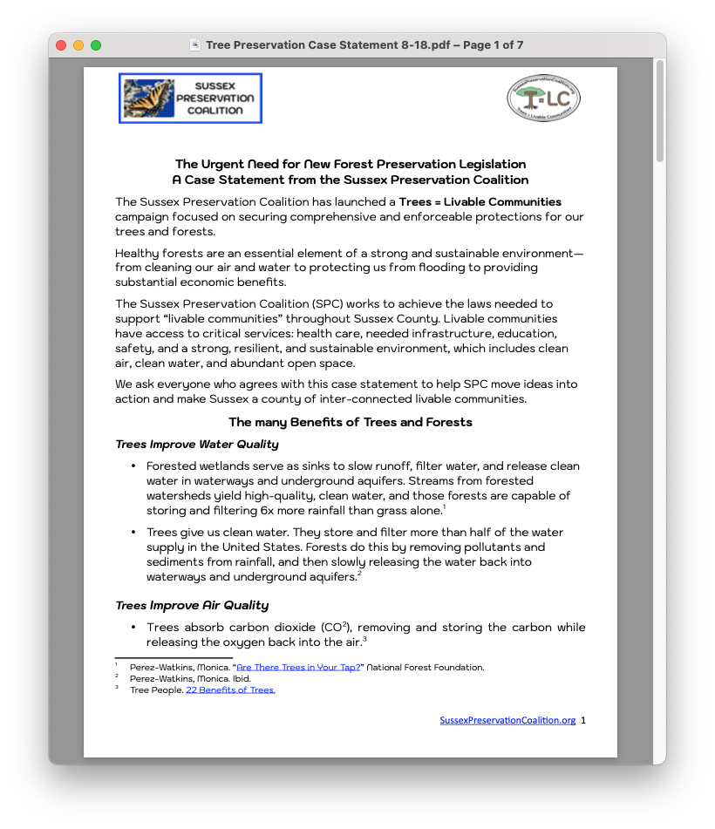
survey approach and administration
Grounded in Facts and Peer-Reviewed Research Based on Primary and Secondary Sources
Open for Responses from 8/1/2023-9/11/2023
Respondents Solicited thru Mailing Lists, Press Releases, and Local Media Coverage
SussexPreservationCoalition.org

Slide 3
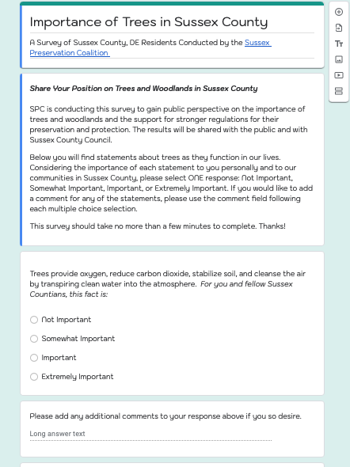
survey design
10 Statements Seeking Multiple Choice Responses with Options to Comment
Respondents Assured Anonymity with Options to Include Email to Follow the Results via SPC
SussexPreservationCoalition.org

Slide 4
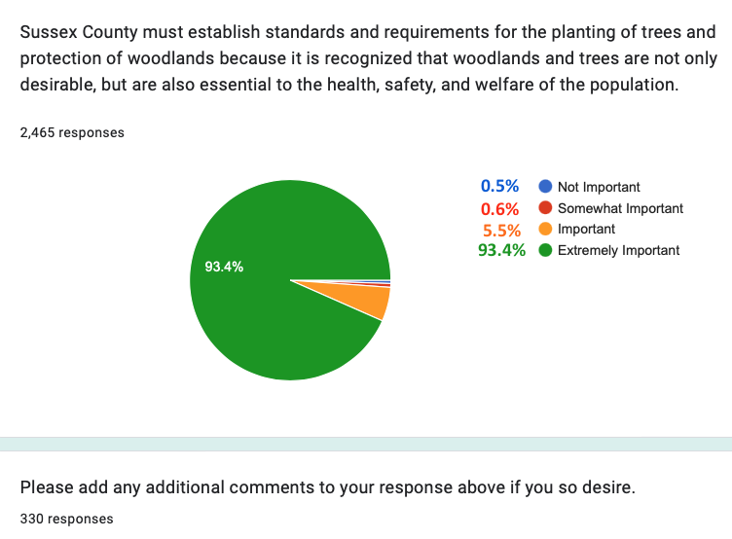
findings,
Quantitative, Question #10
Question #10
Only Question Addressing Policy
SussexPreservationCoalition.org

Slide 5
Primary Areas of concern, #10
Urgency
Citizens’ Health and Welfare vs Private Profit
Deforestation = “Suburbanization” of Sussex County
Elimination of Wildlife
Ravages of Clear Cutting
Flooding
SussexPreservationCoalition.org

Slide 6
Primary Areas of concern, #10
Cont’d
Factoring in Delaware’s Geology
Comparison to Neighboring Jurisdictions
Regulations and Long-Range Planning
Big Picture Horticulture/Ecosystems
Standards’ Impact on the Environment
Climate Change
SussexPreservationCoalition.org

Slide 7
what next?
Full Results of the Survey will be Released Soon on the SPC Website
The SPC Strongly Urges County Council to Consider These FIndings in the Forthcoming Workshop
SussexPreservationCoalition.org

